Slide 1
7th Grade
California Standards
MG3.1 Identify and construct basic elements of geometric figures (e.g., altitudes, midpoints, diagonals, angle bisectors, and perpendicular bisectors; central angles, radii, diameters, and chords of circles) by using a compass and straightedge.

Slide 2
We will identify parts of a circle and find central angle measures
Teacher Reads
Students Read
P/S , NV x2

Slide 3
Warm Up
Remember when we find the percent of a whole number we must change the percent to a decimal and multiply.
Teacher Model
What is 60% of 120?
Students:
2. What is 25% of 360? WB

Slide 4
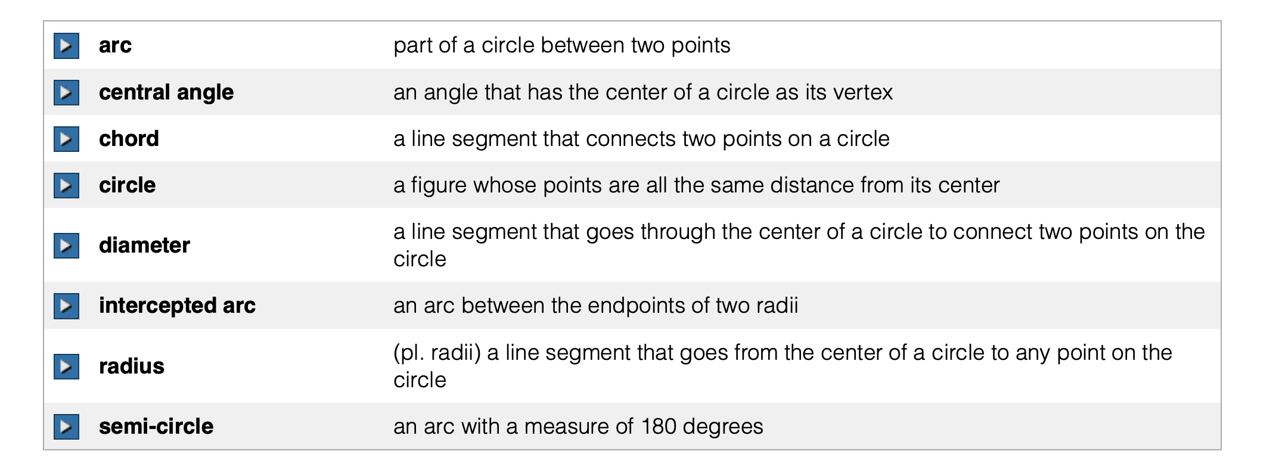
Vocabulary

Slide 5
A circle is the set of all points in a plane that are the same distance from a given point, called the center of a circle. This distance is called the radius of the circle.
A circle is named by its center. For example, if point A is the center of a circle, then the name of the circle is circle A. There are special names for the different parts of a circle.
How do we name a circle? Ps/nv x2

Slide 6
B
A
What is the name of this circle?
WB
How do you know?
Ps/nv x2

Slide 7
Diameter
Arc
Part of a circle named by its endpoints
Line segment that passes
through the center of a circle, and whose endpoints lie on the circle
Radius
Line segment whose endpoints are the center
of a circle and any point on the circle
Chord
Line segment whose
endpoints are any two
points on a circle

Slide 8
What color is the…
Radius?
Diameter?
Arc?
Chord?
wb
How did you know? Ps/nv x2

Slide 9
A central angle of a circle
is an angle formed by two
radii. A sector of a circle
is the part of the circle
enclosed by two radii and an
arc connecting them.
Sector
)
The sum of the measures of all
of the central angles in a circle
is 360°. We say that there are
360° in a circle.
Central angle
What is the sum of all central angles in a circle?
PS/WB

Slide 10
Why is it important to know about parts of a circle?
It will help you read and interpret circle graphs?
You will need to know about the parts of a circle in Algebra and Geometry.
It will be tested.
Why is it important to know about the parts of a circle? Tell your partner. You can use one of my reasons or use one of your own. ps/volunteers

Slide 11

Identify what you are looking for.
Name your starting point.
Name your ending point.
Name the parts of circle M.
A. radii:
MN, MR, MQ, MO
N
How did I/we name the radii? ps
O
B. diameters:
P
NR, QO
M
How did I/we name the diameter?
Q
C. chords:
NR, QO, QN, NP
R
How did I/we know ___ was a chord?
Reading Math
Radii is the plural form of radius.

Slide 12
Name the parts of circle M.
B
A
C
A. radii:
GB, GA, GF, GD
G
B. diameters:
BF, AD
D
H
F
C. chords:
AH, AB, CE,
E
BF, AD

Slide 13

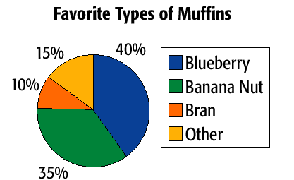
Read the problem
Identify the percentage of the sector
3. Change the percent to a decimal
4. Multiply the decimal by 360º
The circle graph shows the results of a survey about favorite types of muffins. Find the central angle measure of the sector that shows the percent of people whose favorite type of muffin is blueberry.
How did I find the measure of the central angle? Ps/nv
Why did I multiply by 360º? Ps/ nv

Slide 14

Read the problem
Identify the percentage of the sector
3. Change the percent to a decimal
4. Multiply the decimal by 360º
The circle graph shows the results of a survey about favorite types of muffins. Find the central angle measure of the sector that shows the percent of people whose favorite type of muffin is banana nut.
How did we find the measure of the central angle? ps/nv
Why did we multiply by 360º? Ps/ nv

Slide 15
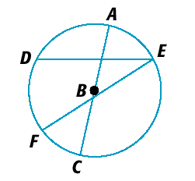
Closure
Name the parts of circle B.
1. radii
2. diameter(s)
3. chord(s)
4.
BA, BC
AC
DE, FE, AC
What is the measure of the central angle of a circle when the sector represents 25% of the circle?
What is something you learned today about circles?

Slide 16
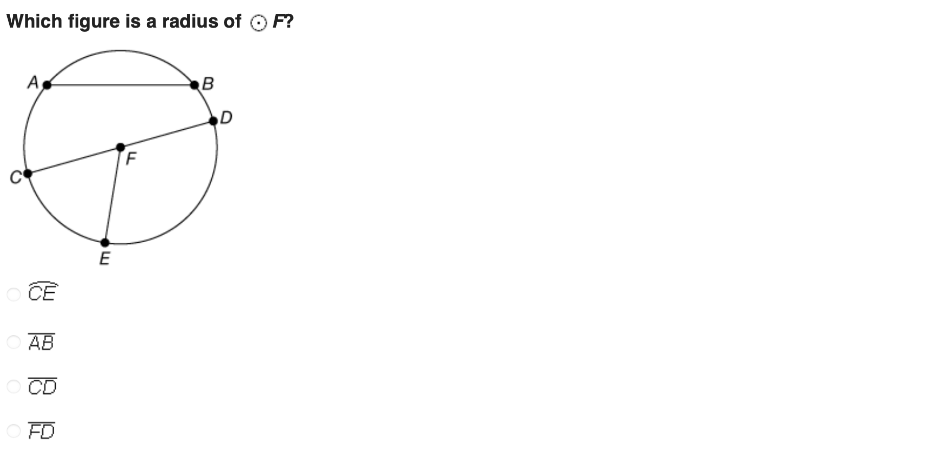

Slide 17
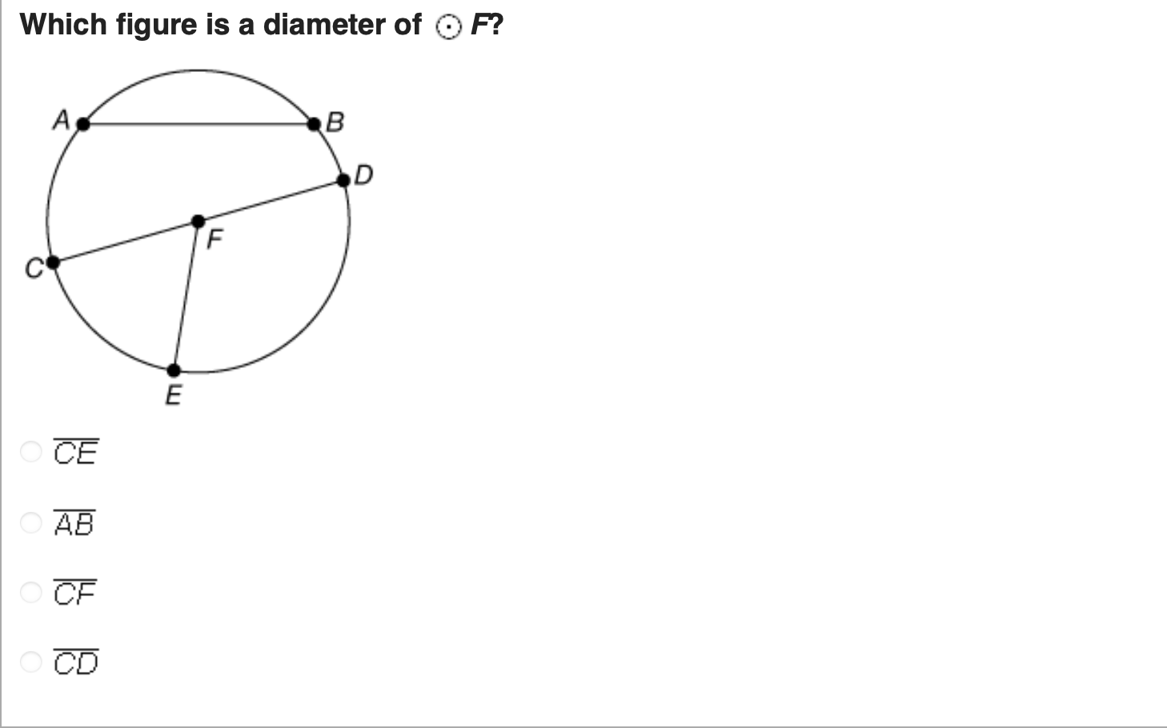

Slide 18
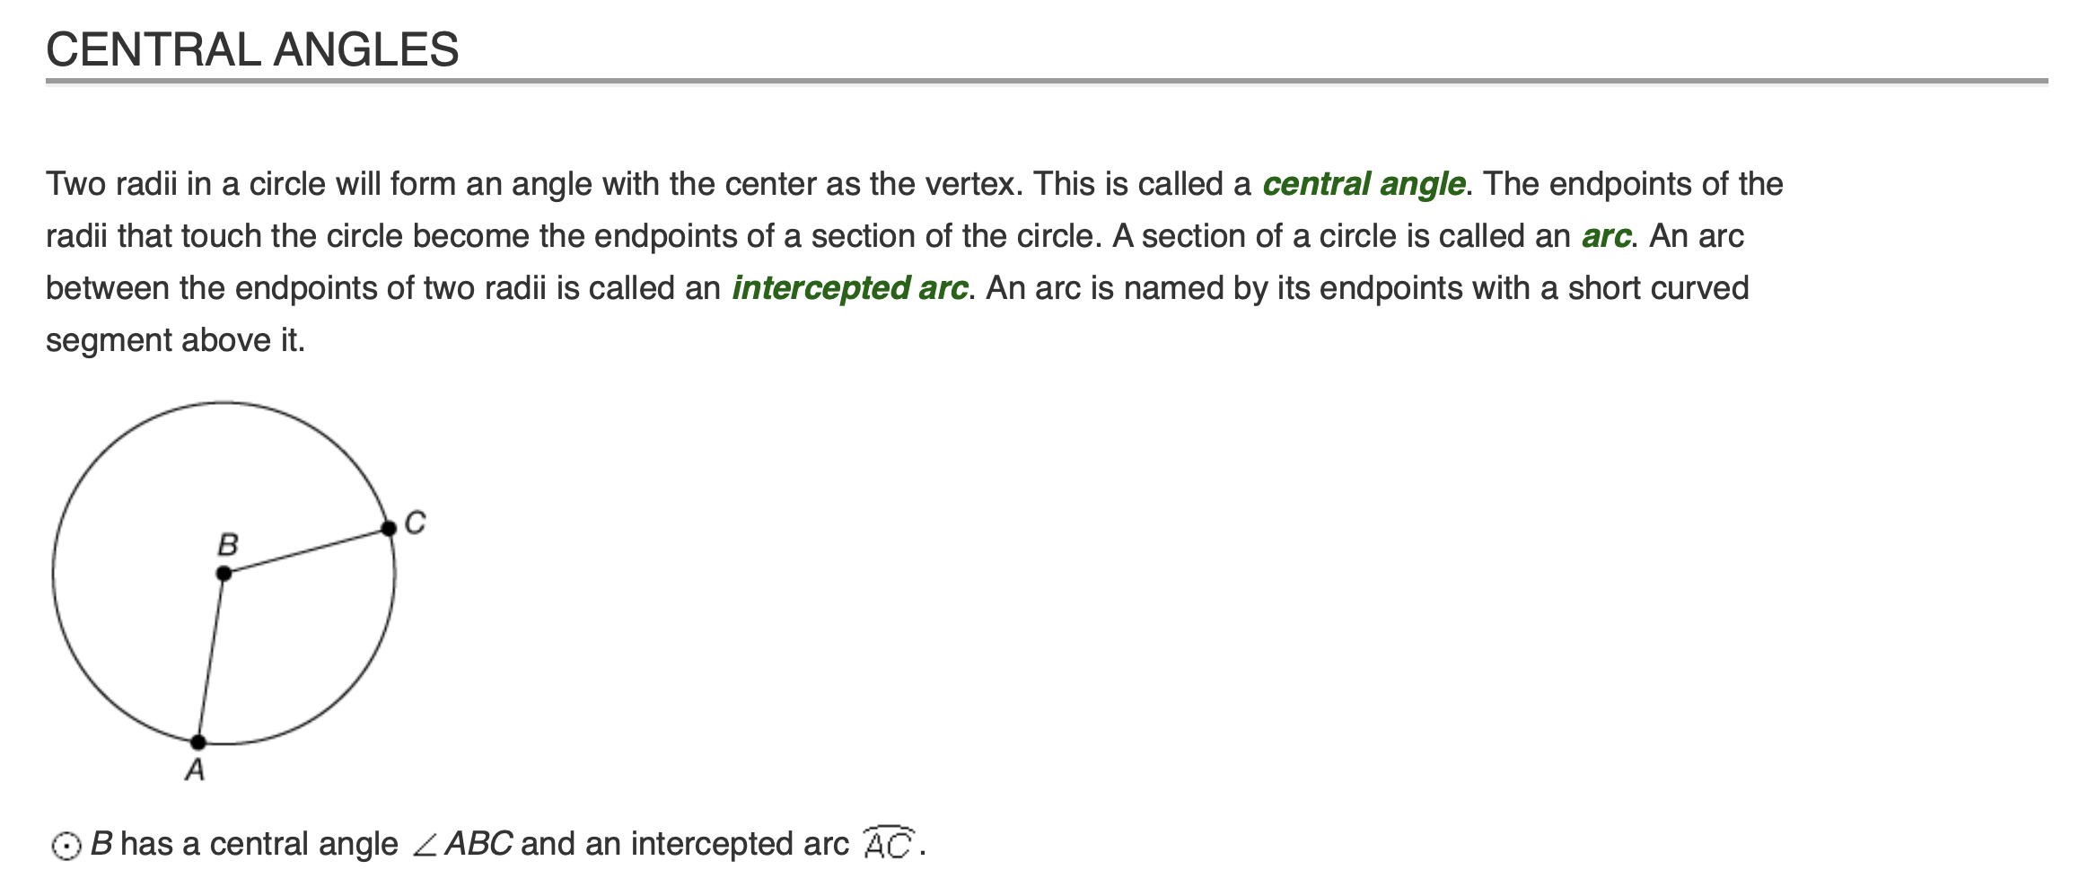
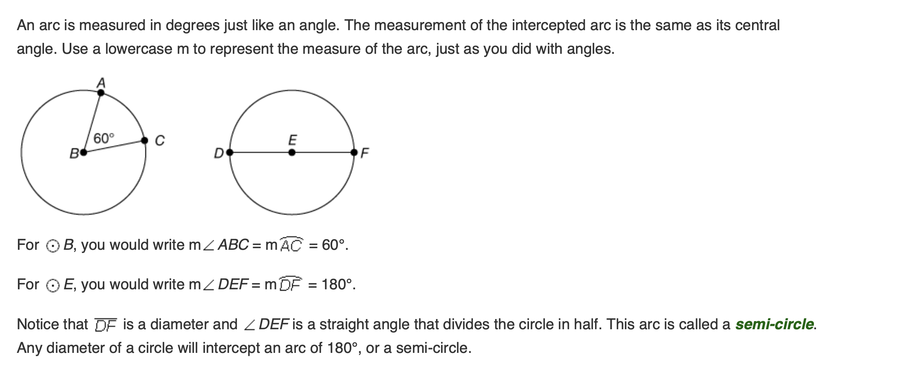

Slide 19
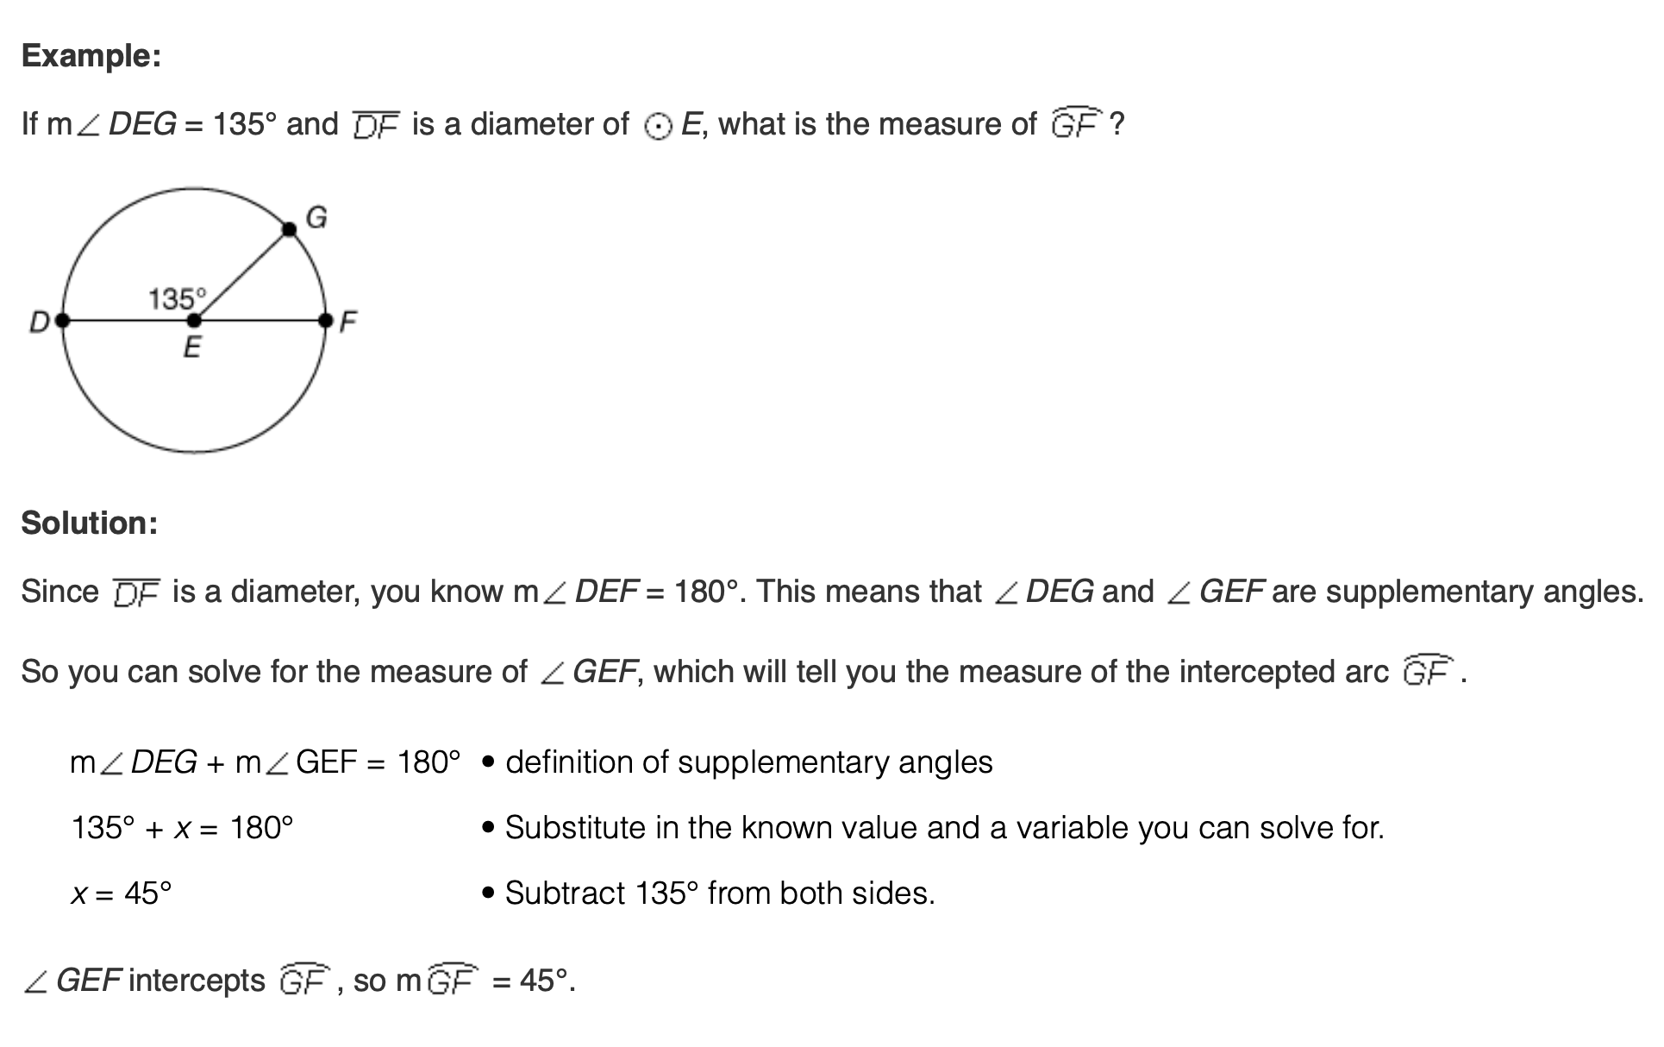

Slide 20
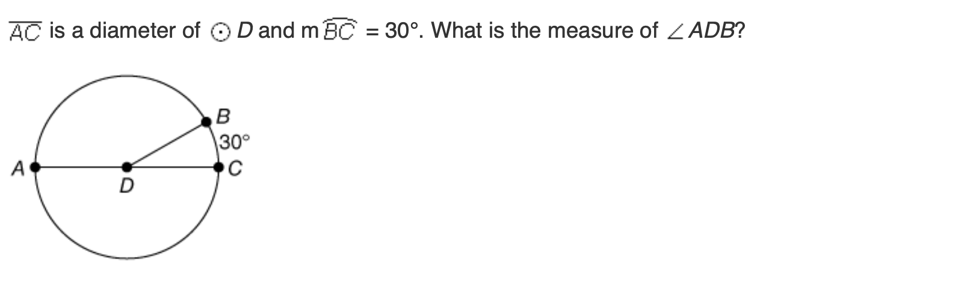
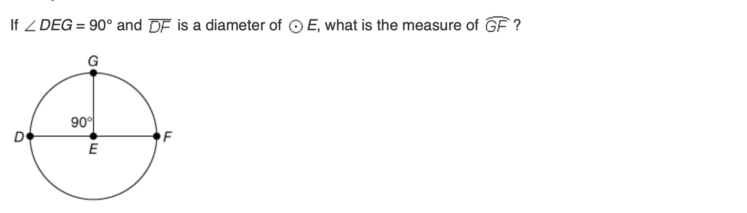

Slide 21
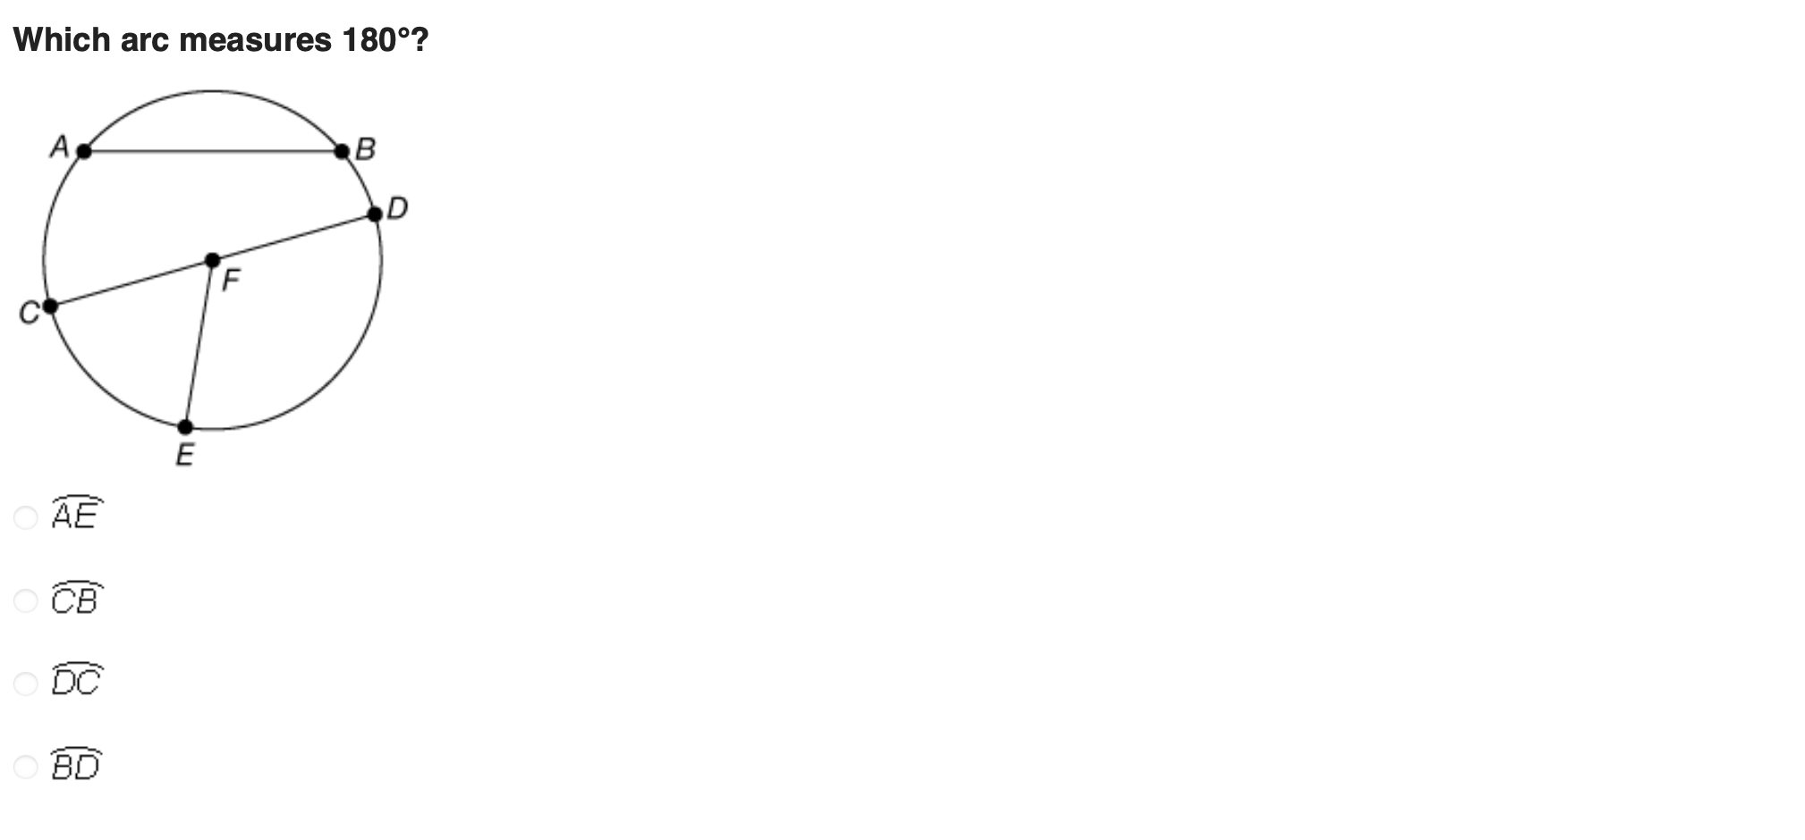

Slide 22
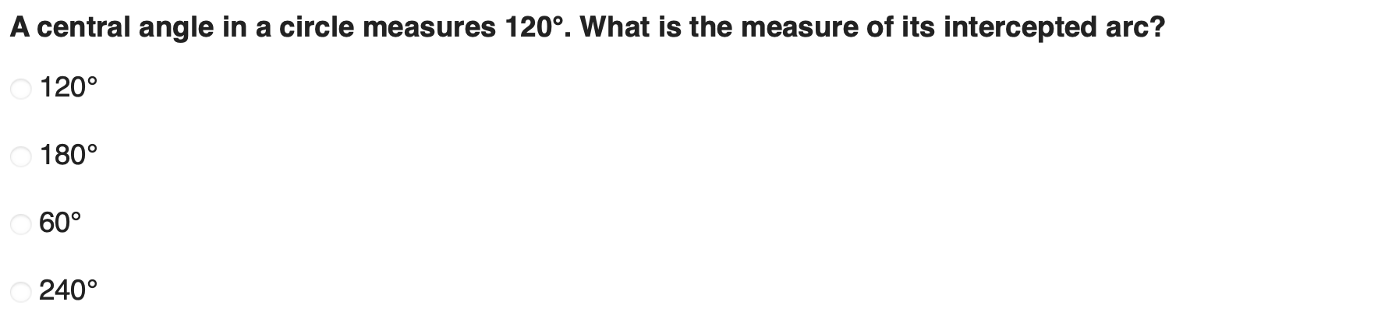
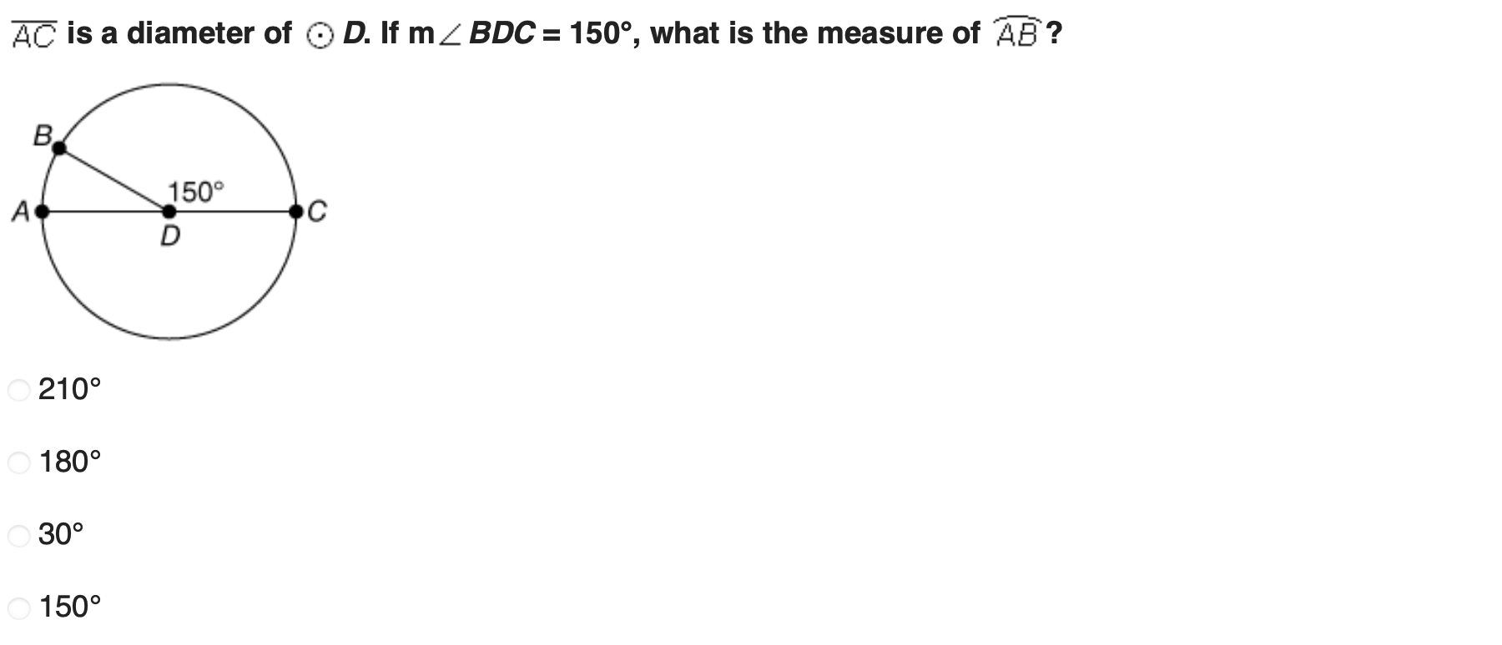

Slide 23
